Slide 1
Brazilian E-Commerce Public Dataset by Olist

Slide 2
The Data ::
The dataset used is the Brazilian E-Commerce Public Dataset by Olist, containing 100,000+ orders from 2016 to 2018 across multiple marketplaces in Brazil. It provides a comprehensive view of e-commerce transactions, including:
Orders: Status, timestamps, and fulfillment details.
Payments: Transaction amounts, types, and installment plans.
Shipping & Logistics: Delivery performance, freight costs, and delays.
Customers: Anonymized location data mapped to ZIP codes.
Products: Categories, dimensions, and seller details.
Reviews: Customer ratings and textual feedback.
Geolocation: Mapping ZIP codes to latitude/longitude for spatial analysis.
The dataset was provided by Olist, a platform connecting small businesses to marketplaces, facilitating order fulfillment through logistics partners. Additionally, a Marketing Funnel dataset is available for analyzing the customer journey from ad exposure to purchase.

Slide 3
Use Case of the Project
Understanding customer behavior and optimizing business strategies based on data-driven insights. This project aims to:
Identify Customer Segments – To help businesses target marketing strategies effectively.
Analyze Customer Sentiment – To understand customer feedback and improve product experience.
Classify Product Performance – To identify high-performing and low-performing products for better inventory and pricing decisions.

Slide 4
Data Preprocessing & Cleaning
Handling Missing Values
Dropped Highly Missing Columns & Rows:
Columns with more than 50% missing values (e.g., review_comment_message) were dropped to ensure data integrity.
Rows with missing values were removed where necessary to maintain analysis accuracy.
Imputation for Delivery Dates:
Missing values in order_delivered_customer_date and order_delivered_carrier_date were imputed using the average delivery and carrier time for each (product_id, customer_city) based on past orders.
The missing values were calculated by adding the respective average time to order_approved_at.
Mean Imputation for Product Attributes:
Missing values in product-related features were filled with their respective mean values:
product_category_name
product_name_length
product_description_length
product_photos_qty
product_weight_g
product_length_cm
product_height_cm
product_width_cm

Slide 5
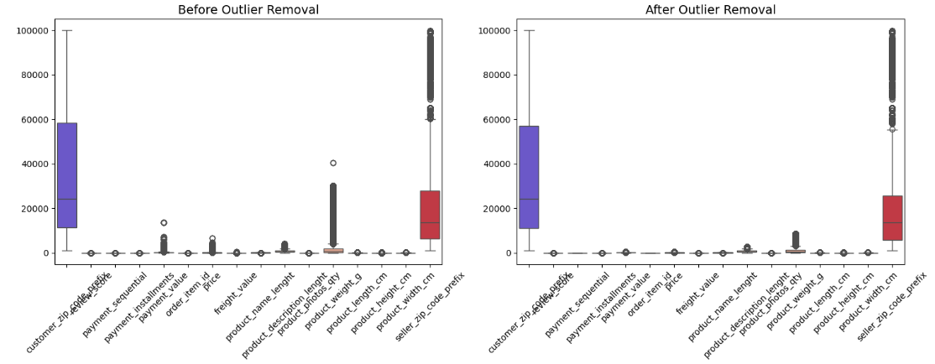
Handling Outliers
Outliers were detected and removed using the Interquartile Range (IQR) method.
Instead of using the standard 25th and 75th percentiles, we applied the 20th and 85th percentiles, ensuring extreme outliers were excluded while retaining meaningful variations.
This helped improve the accuracy of customer segmentation, pricing analysis, and product performance classification.
✔ Removing extreme data points helps identify real spending trends rather than being influenced by rare, high-value transactions. ✔ Ensures better customer segmentation and more accurate pricing analysis.

Slide 6
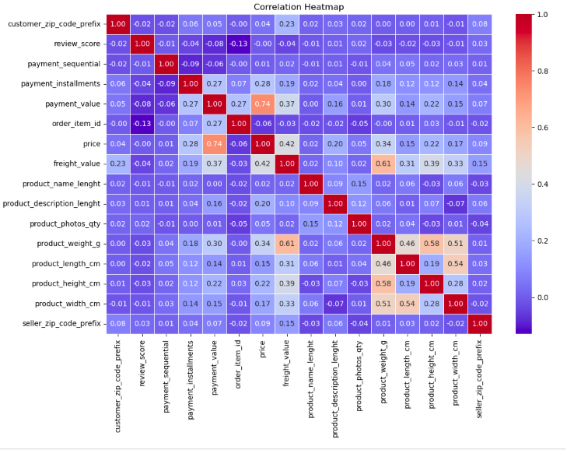
Correlation HeatMap
1.price and payment_value (0.74) indicate that higher product prices lead to higher payment values.
2.freight_value and price (0.42) suggest that expensive products tend to have higher shipping costs.
3.product_weight_g has a notable correlation with freight_value (0.61), meaning heavier products incur higher shipping costs.

Slide 7
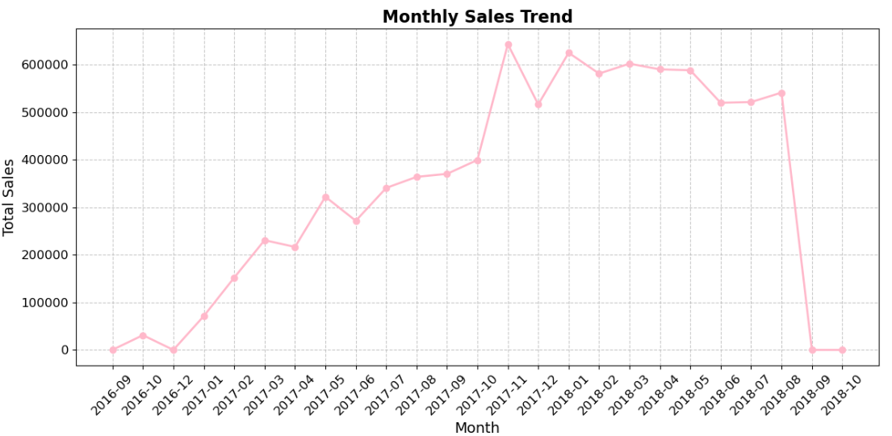
Monthly Sales Trend
Overall Growth Trend: Sales increased consistently from late 2016 to early 2018, indicating rising customer demand and business expansion.
Peak Sales Period: Sales peaked in late 2017 and early 2018, suggesting strong seasonal demand or promotional campaigns.
Stable Sales in 2018: After the peak, sales remained high and stable from January 2018 to mid-2018.
Sudden Drop in September 2018: A sharp decline in sales occurred due to data unavailability, with only three data points, all canceled orders.

Slide 8
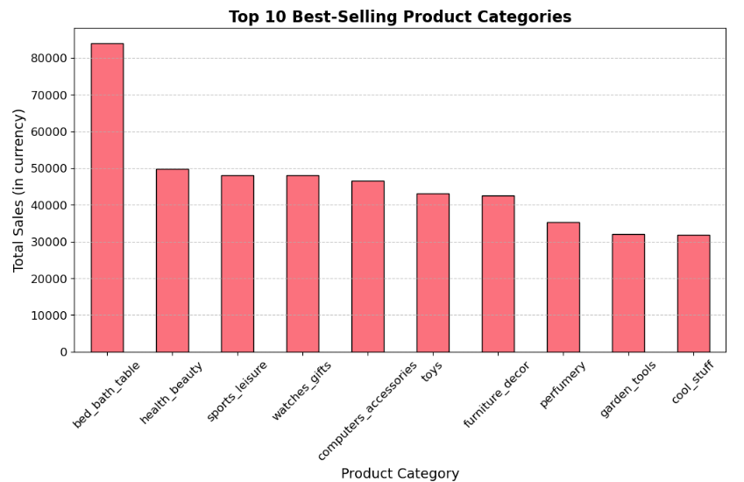
Best Selling Products
Top Category - "bed_bath_table": Highest number of orders, indicating strong consumer demand for home essentials.
Second Most Popular - "health_beauty": High sales reflect a growing interest in personal care and wellness products.
Moderate Sales: Categories like "sports_leisure," "furniture_decor," and "computers_accessories" have similar order volumes, showing steady demand.
Steady Performers - "housewares" and "telephony": Consistent sales highlight the ongoing demand for household essentials and electronic gadgets.

Slide 9
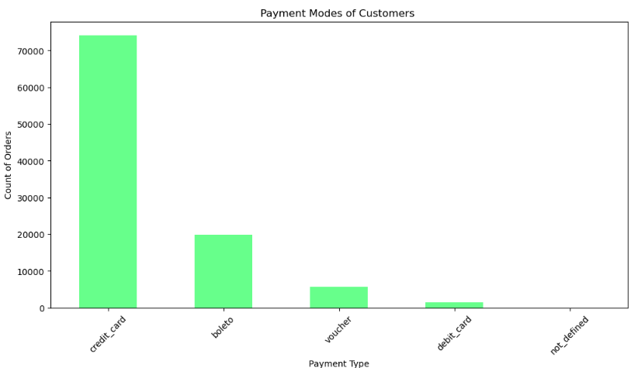
Payment Insights
Key Insights:
Credit Card is the Most Preferred Payment Method: The majority of customers use credit cards, making it the dominant mode of payment.
"Boleto" is the Second Most Used Payment Method: A significant portion of customers opt for bank payment slips, a common payment method in Brazil.
Low Usage of Vouchers and Debit Cards: These methods account for a smaller fraction of transactions, indicating lower customer preference.
Negligible "Not Defined" Payments: Only a very small portion of transactions fall under an undefined category, suggesting minimal data inconsistencies.

Slide 10
Model Building::
Problem Statement 1 : Sentiment Analysis of Customer Reviews
Understanding Customer Feedback: The goal is to analyze customer reviews to identify overall sentiment (Positive, Neutral, or Negative).
Improving Customer Satisfaction: By identifying trends in customer feedback, businesses can improve products, services, and customer experience.
Automating Sentiment Analysis: Instead of manually reviewing thousands of comments, the model automates sentiment classification for efficient decision-making.
Data-Driven Insights for Business Strategy: Helps companies track customer perception over time, identifying areas of improvement and successful product features.

Slide 11
Approach & Methodology
Data Preparation & Cleaning:
Extracted relevant columns (review comment, product category).
Cleaned text by removing punctuation, stopwords, and tokenizing.
Dropped duplicates and missing values.
Sentiment Analysis Using LeIA:
Applied SentimentIntensityAnalyzer to classify reviews as Positive, Neutral, or Negative.
Used compound sentiment scores to determine polarity.
Feature Engineering:
Extracted frequent words and bigrams from reviews.
Transformed text into numerical features using TF-IDF vectorization.
Model Training & Evaluation:
Encoded sentiment labels and split data into training (80%) and testing (20%) sets.
Trained multiple models including Naïve Bayes, Decision Tree, Random Forest, Logistic Regression, XGBoost, LGBM, SVM, AdaBoost, CatBoost, KNN, and Gradient Boosting.
Final Model: CatBoostClassifier achieved 90% accuracy on both training and testing datasets.
Model Deployment:
Saved the trained model, TF-IDF vectorizer, and label encoder using Pickle for future use.

Slide 12
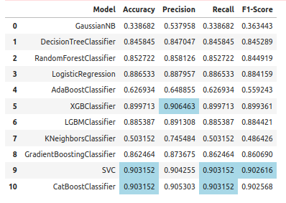
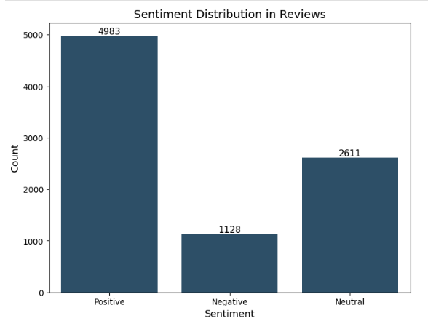
Output Achieved:

Slide 13
Conclusion:
High Accuracy Achieved: The CatBoostClassifier performed best, achieving 90% accuracy for sentiment classification.
2. Business Insights from Sentiment Analysis:
Majority of customers left Positive reviews, indicating overall satisfaction.
Negative reviews highlighted specific product issues, helping businesses improve quality.
3. Scalability & Automation: The model allows for real-time sentiment analysis, reducing manual effort and providing quick insights for decision-making.

Slide 14
Problem Statement 2 : Customer Segmentation Analysis
Customer Segmentation Challenge: Businesses need to identify different types of customers based on their purchasing behavior to enhance marketing strategies.
Understanding Customer Value: Some customers shop frequently, while others make high-value purchases occasionally. A segmentation model helps differentiate them.
Improving Business Decision-Making: By categorizing customers into meaningful groups, businesses can personalize offers, optimize retention strategies, and improve customer engagement.
Data-Driven Targeting: Instead of applying the same strategy for all customers, a segmentation model ensures better resource allocation and revenue growth.

Slide 15
Approach & Methodology
Data Preparation & Cleaning:
Extracted relevant columns (order history, customer ID, purchase timestamps, and total spending).
Converted timestamps into datetime format and computed days since last purchase (Recency).
Feature Engineering (RFM Analysis):
Recency (R): Days since the last purchase.
Frequency (F): Total number of purchases per customer.
Monetary Value (M): Total amount spent by each customer.
Data Normalization:
Used StandardScaler to normalize RFM values for better clustering performance.
Clustering Model - K-Means:
Applied K-Means Clustering (k=4) to segment customers into different groups.
Labeled clusters into VIP Buyers, Loyal Buyers, Frequent Buyers, and Budget Buyers based on RFM scores.
Cluster Visualization:
Created scatter plots for Monetary Value vs. Frequency and Recency vs. Frequency to understand segment distribution.

Slide 16
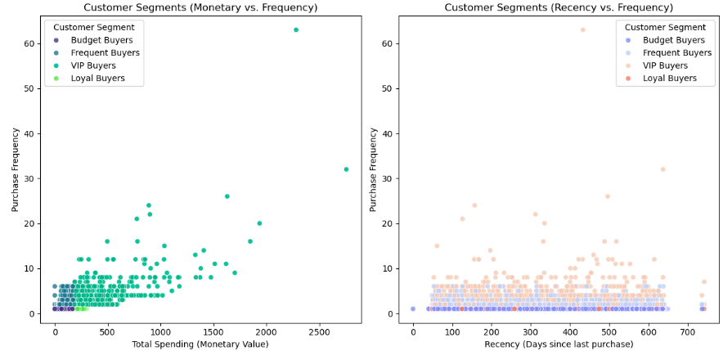
Output:

Slide 17
Conclusion
Successful Customer Segmentation Achieved: Customers were grouped into four distinct segments, helping businesses target them efficiently.
Business Insights Gained:
VIP Buyers: High-spending, frequent shoppers who should be targeted with exclusive offers.
Loyal Buyers: Less frequent but high-value customers, ideal for retention programs.
Frequent Buyers: Regular customers who can be encouraged to spend more.
Budget Buyers: Price-sensitive shoppers who may need discounts or promotions.
Actionable Business Strategies:
Helps in personalized marketing, loyalty programs, and customer retention efforts.
Provides data-driven insights for optimizing promotions and inventory management.

Slide 18
Problem Statement 3 : Product Status Classification
Identifying Product Performance: Businesses need to classify products as Hit, Neutral, or Flop based on their market performance.
Understanding Key Success Factors: Helps in analyzing how sales, customer reviews, and repeat purchases impact product success.
Optimizing Inventory & Marketing: By categorizing products, businesses can invest more in top-performing items and adjust pricing for underperforming products.
Data-Driven Decision-Making: Instead of relying on manual evaluation, a machine learning model automates product classification for better accuracy.

Slide 19
Approach & Methodology
Data Preparation & Feature Engineering:
Extracted relevant features: total sales, units sold, average review score, repeat customers, and original price.
Created a new feature: total price per product using price × order_item_id.
Product Performance Calculation:
Performance Score = Weighted average of total sales, review scores, and repeat customers.
Applied statistical thresholds to classify products:
Hit: Performance score above the 75th percentile.
Neutral: Products with an average performance score.
Flop: Performance score below the 25th percentile.
Model Training & Classification:
Encoded product status labels (Hit = 1, Neutral = 0, Flop = -1).
Used TF-IDF vectorization for text-based features.
Trained multiple classifiers, including Decision Trees, Random Forest, Logistic Regression, XGBoost, LGBM, CatBoost, and SVM.
Final Model: CatBoostClassifier achieved the best accuracy for classification.
Visualization & Analysis:
Plotted the distribution of product categories based on performance classification.
Compared previous product classification methods with the new improved model.

Slide 20
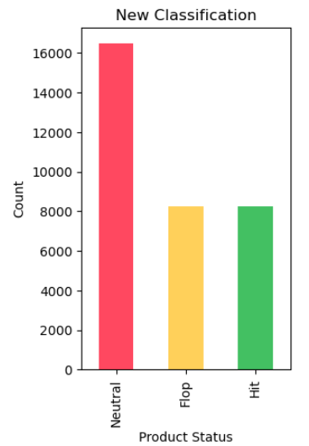
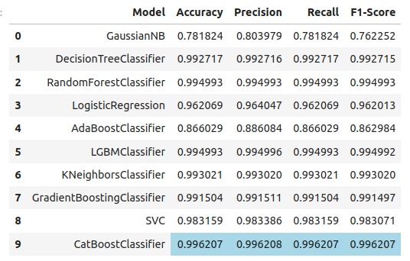
OUTPUT::

Slide 21
Conclusion
Effective Product Classification Achieved: The model successfully categorized products into Hit, Neutral, or Flop based on real-world sales data.
Key Business Insights:
Hit Products: Ideal for further promotions, discounts, and increased inventory.
Neutral Products: Potential candidates for price adjustments and bundling strategies.
Flop Products: Require re-evaluation, possible discontinuation, or heavy discounts.
Strategic Business Benefits:
Helps reduce inventory waste by focusing on high-demand products.
Enables better marketing and pricing strategies for underperforming products.
Allows businesses to forecast future product success based on past trends.

